Slide 1

GenAI & AI Literacy for Teachers
An introduction
VU CTL Short | Centre for Teaching & Learning

Slide 2
Can you use GenAI for feedback and grading?
Impact of GenAI on learning
Can you use GenAI to retrieve and process information?
Environmental impact of GenAI
AI literacy among students: what teachers need to know
Impact of GenAI on academic integrity
Bring your teaching to life: AI roleplay
KNOWLEDGE & SKILLS
CORE CONCEPTS
DESIGNING & STRENGTHENING EDUCATION
BROAD & SOCIETAL IMPACT
GenAI & AI literacy for teachers: an introduction
Impact of GenAI on assessment
Powerful teaching with Socratic bots, quiz bots and debate bots
Prompting for beginners
Using GenAI for educational design
LLMs and technical applications
Societal impact of GenAI
Powerful prompting

Slide 3
Program
Welcome, let me introduce ourselves – EN or NL?
Identify who already has what kind of experiences with using genAI
Discussion about UvA-VU Taskforce advice
Discussions about the Companion
Considerations/final discussion

Slide 4
Learning objectives
Explain what AI literacy means for you as a teacher and why it is relevant within your own teaching practice.
Analyse components of frameworks such as UvA-VU Taskforce framework and relate them to your own teaching practice.
Describe the main dilemmas surrounding the impact of GenAI on learning, teaching, and assessment.
Reflect on your own knowledge, attitudes, and skills regarding GenAI and identify areas for further development.

Slide 5

First thoughts
In pairs: discuss what you think AI Literacy would mean for Teachers. What would then need to know and be able to do?
Make a list and paste on the board

Slide 6
VU-UvA Taskforce
I. What – Knowledge and understanding (Theoretical basis)
  Technical understanding: Being able to explain how the technology behind AI, such as Large Language Models (LLMs), works.
  Data literacy: Understanding that AI models are created by collecting and processing vast amounts of data.
  Basic programming concepts: Being able to explain concepts such as data structures in broad terms.
  Machine and deep learning: Be able to explain the basic concepts involved (such as train/tune/test sets, embedding and gradient descent).
  Algorithms: Be able to explain, in broad terms, how modern, self-learning algorithms work.
  Subject-specific tools: Be familiar with the specific AI applications and language models relevant to one’s own field of study.

Slide 7
VU-UvA Taskforce
II. How – Understanding and application (Practical skills). This involves putting technical knowledge into practice and making informed choices when using software:
  Identifying software issues: Understanding different types of applications (such as classification, regression, generation and machine translation) and being aware of the associated risks (such as fairness, bias, hate speech, energy consumption and intellectual property).
  Careful consideration of use: Being able to assess when the use of (generative) AI is useful or desirable, so that you do not constantly relinquish your own critical thinking.
  Carrying out in-depth critical thinking independently: Being encouraged to practise complex writing processes and gain experience without resorting too quickly to AI for a summary or text.
  Choice of data source: Being able to methodically determine which source (for example, a lecturer, fellow student, academic literature or chatbot) is most suitable for a specific question, whilst also taking into account sustainability and the high energy and water consumption of LLMs.
  Targeted prompts: Demonstrating the ability to draft effective and meaningful prompts.

Slide 8
VU-UvA Taskforce
III. Why – Ethics and judgement (Critical reflection). This category forms the academic core, closely intertwined with the principles of academic integrity :
  Ethical reasoning: To formulate various ethical and theoretical arguments for and against the use of AI.
  Critical quality control: Be able to assess AI output within one’s own discipline against quality criteria (in terms of reasoning and ethics), whilst recognising that AI output offers only one perspective, the primary source of which cannot be traced.
  Copyright and annotation: Take copyright into account and know how AI output should be annotated in a sound and transparent manner.
  Subject-specific reflection: Be able to reflect on where, within the values and context of one’s own discipline (for example, the author-reader or employer-employee relationship), it is or is not desirable to use AI.
  Privacy and data protection: Always keep one’s own privacy and the protection of general data in mind when working with AI systems.

Slide 9
AI Literacy Companion
For Students (added)
Environmental Impact
Work and Societal Impact
What is your AI Aware future
For Teachers
?

Slide 10
Self Assessment
2 | What is generative AI, and what can you do with it?
3 | Risks and opportunities for your learning
4 | How do you ensure good output when using generative AI
5 | Language models: what's under the hood of your generative AI system?
6 | Chat software: a neat wrapper around your LLM
7 | How does your AI use impact the environment?
8 | Generative AI and work
9 | Societal forces around AI
10 | Your AI aware future
Read the Titles of the Chapters of the Student Companion and the Teacher Companion.
Rate yourself on your knowledge and skill for those Chapters
In pairs: discuss why you gave yourself that rating. What do you know and are able to?
2 | Using generative AI tools
3 | Generative AI and educational design
4 | The wicked problem of AI in Education
5 | Rethinking learning outcomes in the age of generative AI
6 | Critical thinking
7 | Generative AI and Assessment
8 | Generating feedback on assignments
9 | Grading open-ended exam questions

Slide 11
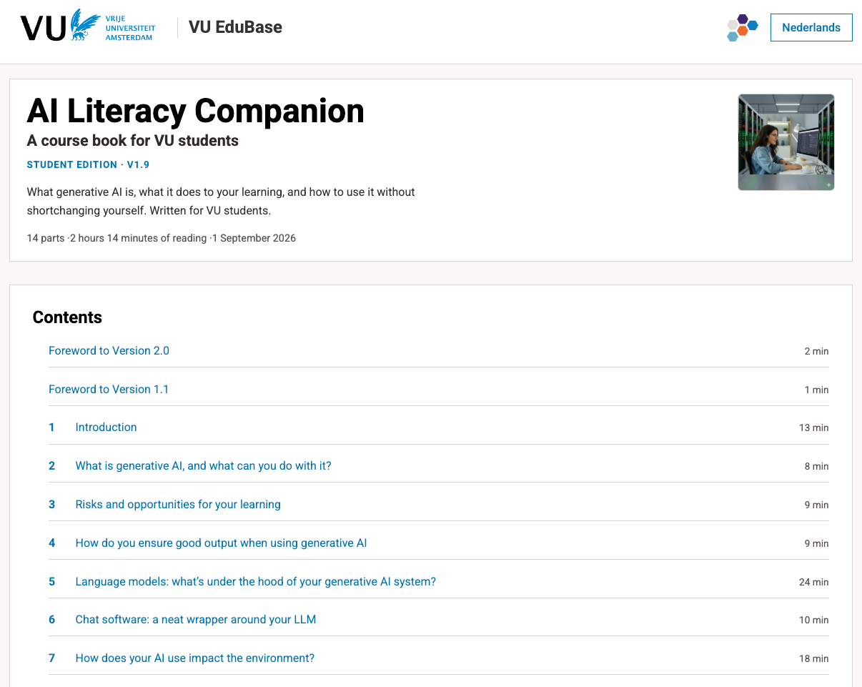
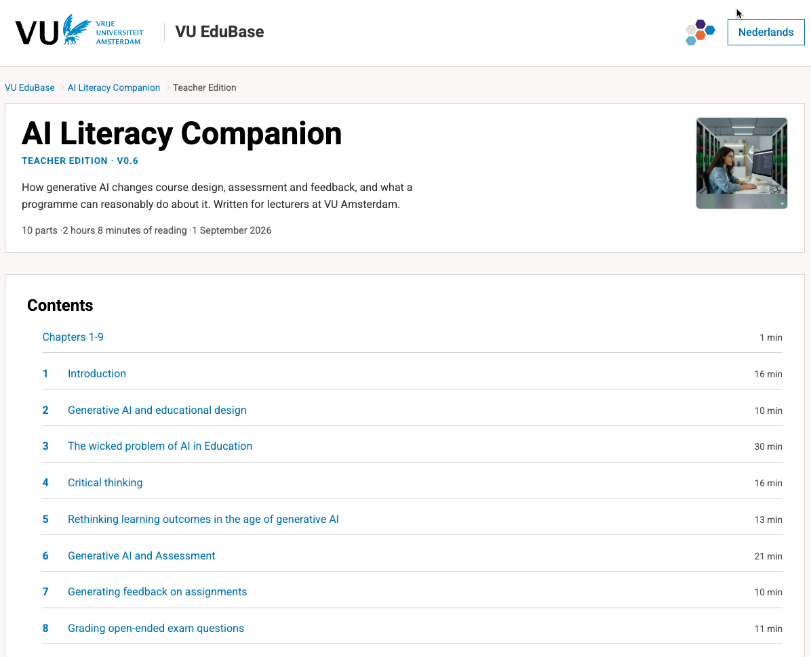
Self Assessment
Read the Titles of the Chapters of the Student Companion and the Teacher Companion.
Rate yourself on your knowledge and skill for those Chapters
In pairs: discuss why you gave yourself that rating. What do you know and are able to?

Slide 12
What are the key concepts?
Sit down together at your laptop
Go to https://edubase.vu-edulab.nl/companion/docenteneditie/
  Or https://edubase.vu-edulab.nl/chat/
Discuss the results with each other

Slide 13
Thank you

