Slide 1

AI Literacy
What teachers need to know about student’s (lack of) AI-literacy
VU CTL Short | Centre for Teaching & Learning

Slide 2
Can you use GenAI for feedback and grading?
Impact of GenAI on learning
Can you use GenAI to retrieve and process information?
Environmental impact of GenAI
AI literacy among students: what teachers need to know
Impact of GenAI on academic integrity
Bring your teaching to life: AI roleplay
KNOWLEDGE & SKILLS
CORE CONCEPTS
DESIGNING & STRENGTHENING EDUCATION
BROAD & SOCIETAL IMPACT
GenAI & AI literacy for teachers: an introduction
Impact of GenAI on assessment
Powerful teaching with Socratic bots, quiz bots and debate bots
Prompting for beginners
Using GenAI for educational design
LLMs and technical applications
Societal impact of GenAI
Powerful prompting

Slide 3
Can you use GenAI for feedback and grading?
Impact of GenAI on learning
Can you use GenAI to retrieve and process information?
Environmental impact of GenAI
AI literacy among students: what teachers need to know
Impact of GenAI on academic integrity
Bring your teaching to life: AI roleplay
KNOWLEDGE & SKILLS
CORE CONCEPTS
DESIGNING & STRENGTHENING EDUCATION
BROAD & SOCIETAL IMPACT
GenAI & AI literacy for teachers: an introduction
Impact of GenAI on assessment
Powerful teaching with Socratic bots, quiz bots and debate bots
Prompting for beginners
Using GenAI for educational design
LLMs and technical applications
Societal impact of GenAI
Powerful prompting

Slide 4
Programma
Welkom, even voorstellen – EN of NL?
Inventariseren wie al wat voor soort ervaringen heeft met studentengebruik van genAI
Discussie over UvA-VU Taskforce advies
Discussies over de Companion
Overwegingen/einddiscussie

Slide 5
Learning objectives
You can describe and distinguish between key concepts relating to AI.
You can explain what AI literacy means for students and explain why AI literacy is relevant to your own teaching practice.
You can identify and analyse common misconceptions and concerns surrounding GenAI.
You can discuss these concerns with your students in a constructive manner

Slide 6

First thoughts
In pairs: discuss what you think AI Literacy is and what students should know and be able to do
Make a list and paste on the board
Divide the list in what students already do know and do not know.

Slide 7
Line up
I am a digital native and know how to use generative AI

Slide 8
Line up
Students are ‘digital natives’ and know how to use generative AI

Slide 9
Line up
Student can learn to be AI literate in one lecture

Slide 10
Line up
Students know how the AI technology works and how algorithms work

Slide 11
Line up
I find it difficult to start a conversation with students about generative AI

Slide 12
Line up
I have students who do not want to use generative AI

Slide 13
Line up
Students do not comply with a ban on the use of generative AI in my course

Slide 14
Line up
Students aren’t interested in how LLMs are created; they just want to use them

Slide 15
Line up
In my degree programme, we have consensus on our students use (or not) of genAI

Slide 16
VU-UvA Taskforce
I. What – Knowledge and understanding (Theoretical basis)
  Technical understanding: Being able to explain how the technology behind AI, such as Large Language Models (LLMs), works.
  Data literacy: Understanding that AI models are created by collecting and processing vast amounts of data.
  Basic programming concepts: Being able to explain concepts such as data structures in broad terms.
  Machine and deep learning: Be able to explain the basic concepts involved (such as train/tune/test sets, embedding and gradient descent).
  Algorithms: Be able to explain, in broad terms, how modern, self-learning algorithms work.
  Subject-specific tools: Be familiar with the specific AI applications and language models relevant to one’s own field of study.

Slide 17
VU-UvA Taskforce
II. How – Understanding and application (Practical skills). This involves putting technical knowledge into practice and making informed choices when using software:
  Identifying software issues: Understanding different types of applications (such as classification, regression, generation and machine translation) and being aware of the associated risks (such as fairness, bias, hate speech, energy consumption and intellectual property).
  Careful consideration of use: Being able to assess when the use of (generative) AI is useful or desirable, so that you do not constantly relinquish your own critical thinking.
  Carrying out in-depth critical thinking independently: Being encouraged to practise complex writing processes and gain experience without resorting too quickly to AI for a summary or text.
  Choice of data source: Being able to methodically determine which source (for example, a lecturer, fellow student, academic literature or chatbot) is most suitable for a specific question, whilst also taking into account sustainability and the high energy and water consumption of LLMs.
  Targeted prompts: Demonstrating the ability to draft effective and meaningful prompts.

Slide 18
VU-UvA Taskforce
III. Why – Ethics and judgement (Critical reflection). This category forms the academic core, closely intertwined with the principles of academic integrity :
  Ethical reasoning: To formulate various ethical and theoretical arguments for and against the use of AI.
  Critical quality control: Be able to assess AI output within one’s own discipline against quality criteria (in terms of reasoning and ethics), whilst recognising that AI output offers only one perspective, the primary source of which cannot be traced.
  Copyright and annotation: Take copyright into account and know how AI output should be annotated in a sound and transparent manner.
  Subject-specific reflection: Be able to reflect on where, within the values and context of one’s own discipline (for example, the author-reader or employer-employee relationship), it is or is not desirable to use AI.
  Privacy and data protection: Always keep one’s own privacy and the protection of general data in mind when working with AI systems.

Slide 19
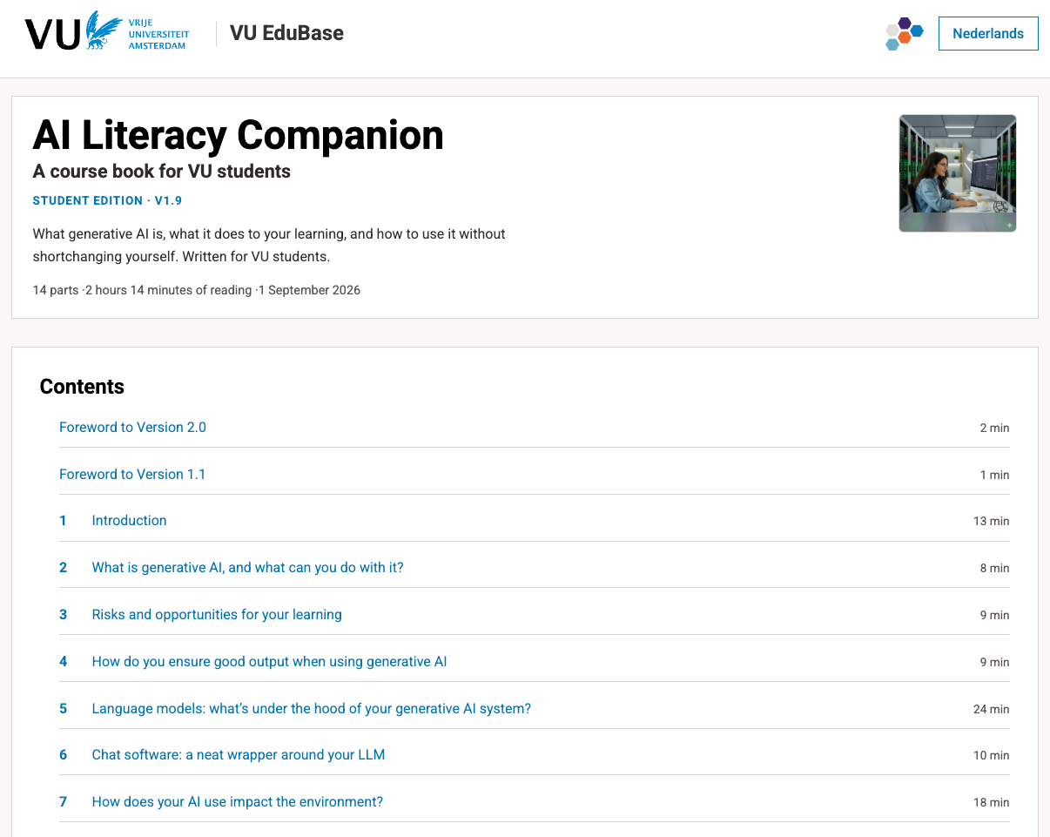
Materials
AI Literacy Companion – a course book for VU students

Slide 20
What are the key concepts?
Sit down together at your laptop
Ask Gemini Notebook what the 10 key concepts from the Companion are
Ask Gemini Notebook how the Companion relates to the Task Force’s recommendations?
Discuss the results with each other
Ask the questions again
Discuss the results again
In UvA-VU Taskforce weinig aandacht voor Milieu en Maatschappelijke impact

Slide 21

Obvious truths
By remaining vague about what is and isn’t allowed:
  Students will use AI less
  But they also feel very uncertain
Students overestimate their own digital skills and their ability to craft prompts
Students STILL make the most obvious mistakes:
  Failing to check references
  Lacking a feel for the text when writing
Lecturers overestimate their students’ digital skills and their ability to craft prompts
Students feel embarrassed about disclosing information about their AI use (request for disclosure, etc.)
Students believe they learn more when they use AI

Slide 22
Nu je weet hoe voor studenten
Kom naar de volgende meeting over AI geletterdheid voor docenten … want die moeten ook weten hoe ze studenten AI Geletterd maken …
Action
Talk with some colleagues about the goals of AI Lteracy and how it could be incorporated in your curriculum/discipline

